Slide 1





Festivals

Slide 2
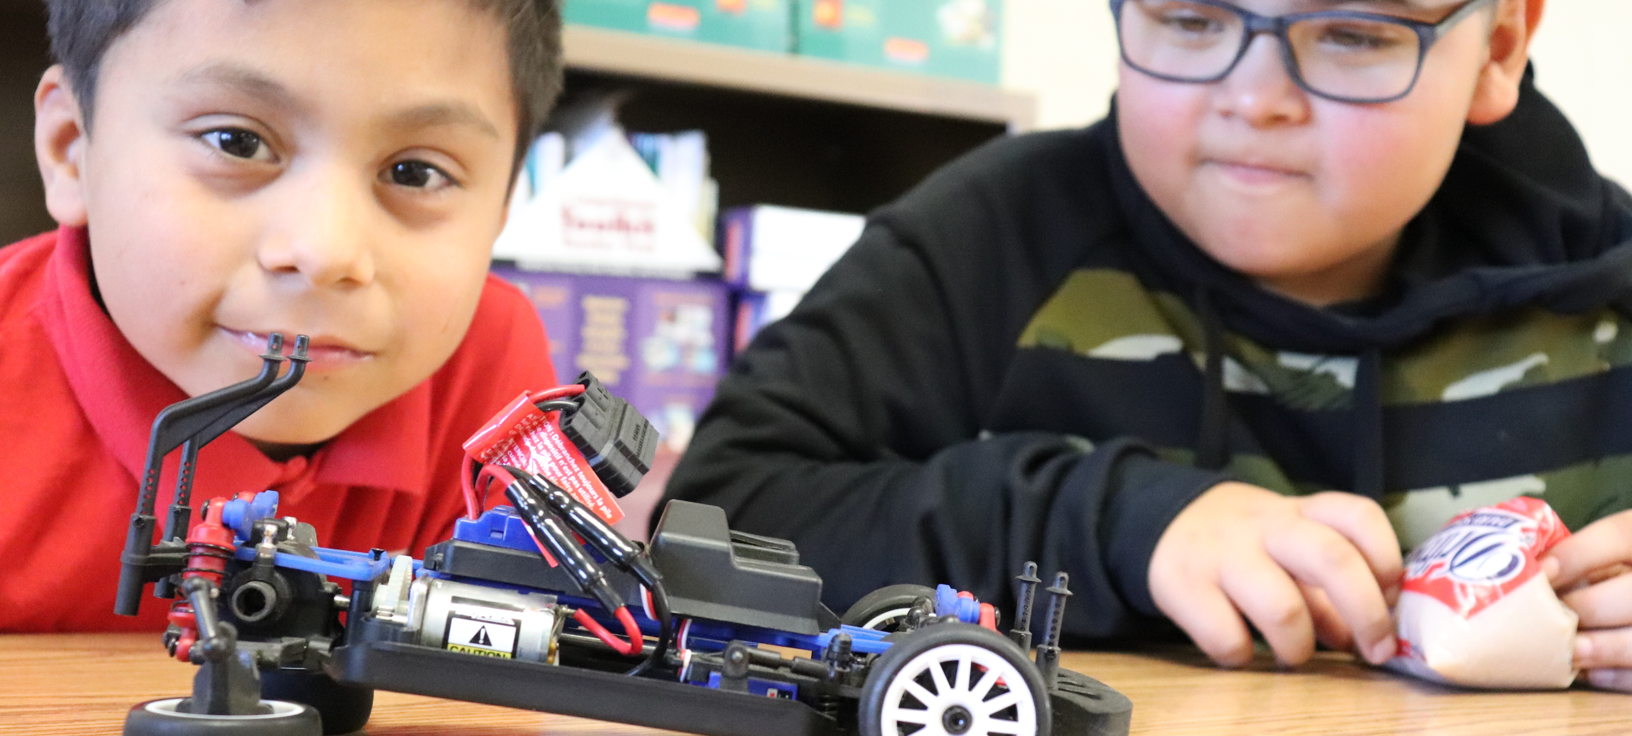


Art of STEM Festivals
Planning for Success
Helping Communities Thrive
Launch & Learn
Scalability
Sustainability
All Access Pass

Slide 3



Introduction
The Art of STEM Festivals were developed to inspire and motivate all members of a learning community with educator training, family outreach, and instructional resources for students.
Customized festival content helps hosts introduce students and families to STEM, problem-solving, and career paths available in local industries.
This Photo by Unknown Author is licensed under CC BY

Slide 4

Helping Communities Thrive
Celebrate Learning

Slide 5




4 Stages to Launch Your AoS Experience
1
2
3
4
Plan with Local Industry in Mind
Train Staff, Mentors & Local Volunteers
Celebrate STEM with a Festival
Provide Continued Learning & Content
Stakeholders & funders share messaging to help students discover opportunities in science, manufacturing, trades, medicine, technology, engineering, and business.
Hold a half-day workshop for adults in your organization. Focus on curriculum, missed math skills, generalized confidence in STEM or redelivery of Art of STEM festivals locally.
Host a grade level, an entire student body, district schools, and community groups. Or open the event to neighbors, families and caregivers in your network.
Your newly trained staff is ready to log into iNSL’s All Access Pass curriculum site to deliver targeted research-based content for classrooms, camps & clubs.

Slide 6
Gen Z knows what it wants.
70%
46%
of students
of students
have already decided on future employers by high school graduation or early in their college studies.
In high school have already picked out future employers by senior year.
To access additional data about Gen Z and compare interest by race, gender, career interest, and education level, request the interactive Tallo report here.

Slide 7
What careers interest Gen Z?
To access additional data about Gen Z and compare interest by race, gender, career interest, and education level, request the interactive Tallo report here.

Slide 8
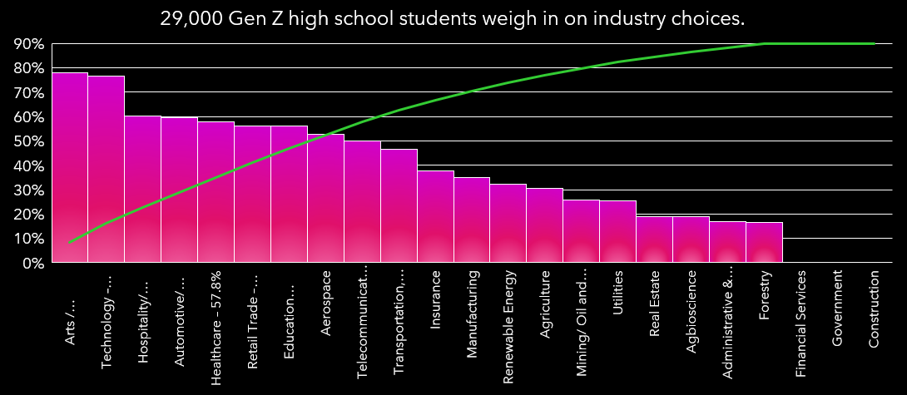
What Industries Interest Gen Z?
To access additional data about Gen Z and compare interest by race, gender, career interest, and education level, request the interactive Tallo report here.

Slide 10
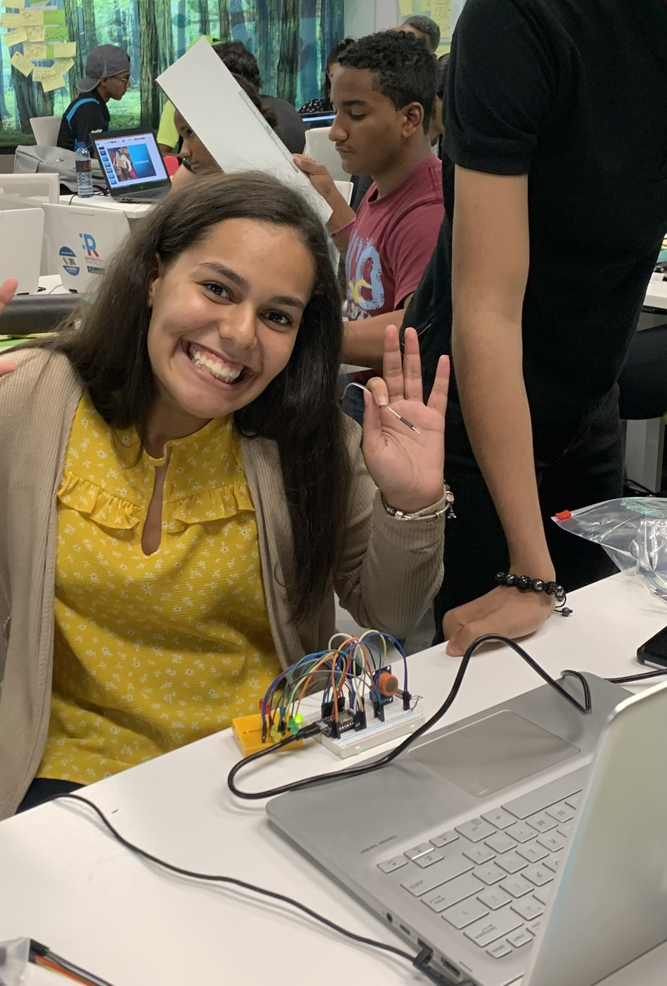
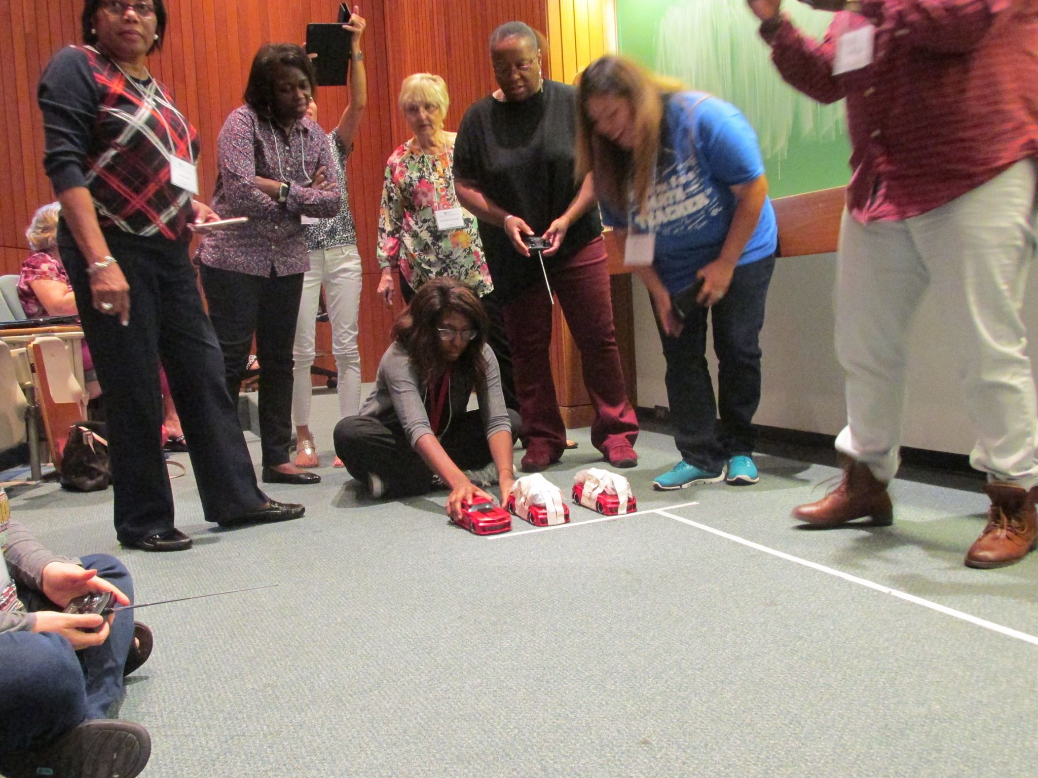

Art of STEM
Launch & Learn
Start by inspiring the adults.

Slide 11
